Slide 1

Would you like a glass of wine ?
Data Science & AI Program by Institute of Data 2022
Mini Project 1
Jes Colbourne
How to convert a virtual No to Yes!

Slide 2
Australian wine industry
Australian wine sector contributes over $40 billion annually to the Australian economy.
In 2020-21, domestic sales by volume are from off-trade channel
includes retail outlets (66%), online/e-commerce (19%) and direct sales to customer (13%)
COVID-19 pandemic caused a decrease in wine purchasing across most channels except for online retailers

Slide 3

Australian wine industry
70% share of wine sales online is dominated by the ‘Big-Box’ retailers ie Dan Murphy’s, BWS and Liquorland as they invest heavily on eCommerce platforms

Slide 4
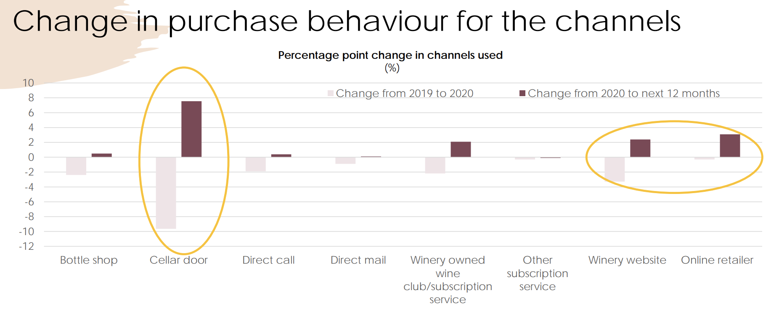
What about our local producers?
Wineries are regaining customer interests after Covid but their online sales declined while those in Online retailer is still steady

Slide 5
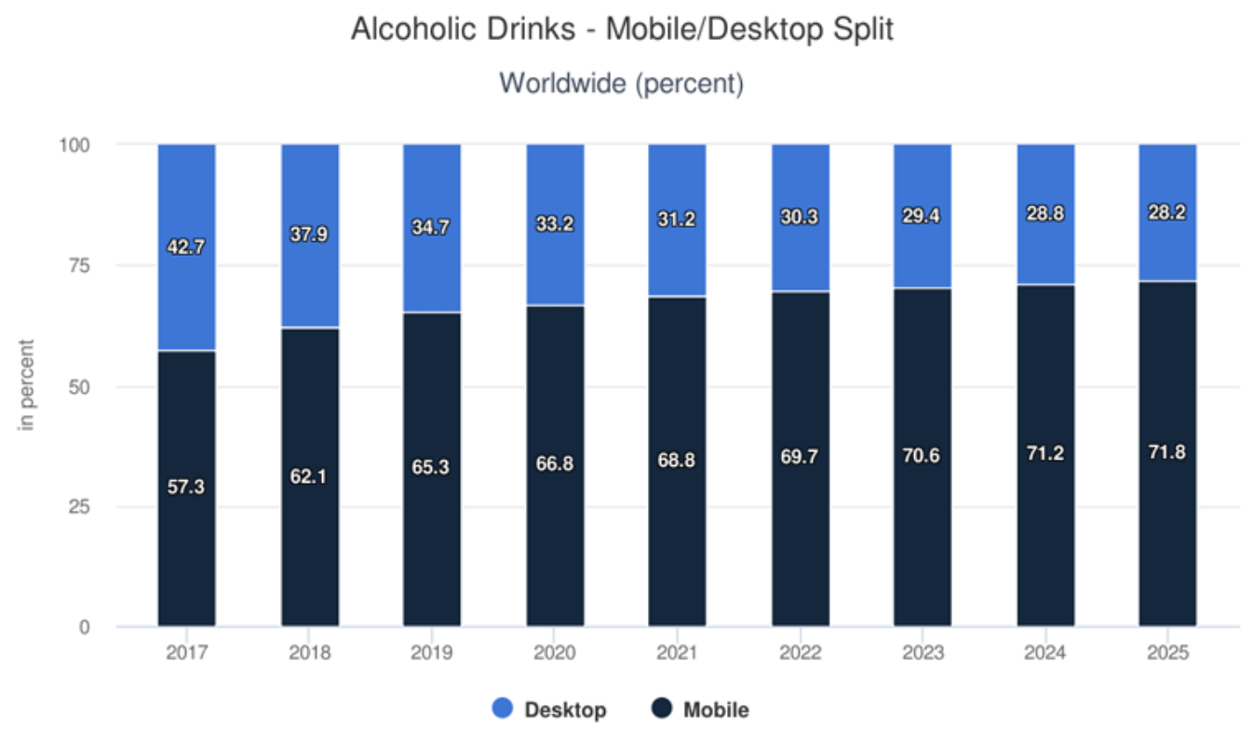

What about our local producers?
Meanwhile, 70% of global online alcohol sales are from mobile devices and expected to reach 72% by 2025

Slide 6
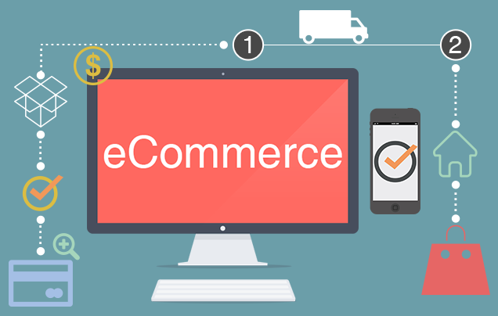
So what is the Cost of e-commerce website ?
Web design & development prices can range from $10,000 - $250,000 or more including
Maintenance
Domain Name
Web hosting
SSL Certificate
Email Services
Tech Support
Website Design
Plugins
eCommerce Features
Marketing and SEO

Slide 7

Business question
Is it worth investing in e-commerce platform to gain more sales?

Slide 8
Data pipeline
Prepare
Wrangle
Clean
Profile
Munge
Define
Set an object
Gathering data
Set a strategy
Deliver
Visualize
Summarize
Advise/Build
Deploy
Analyse
Model
Predict
Revise
Evaluate

Slide 9
Dataset description
Based on 2,239 observations of customer personality with 27 Features including
Demographic ie Income, Education
Products; Wines, Meat products, Sweet products
Promotion; Number deal purchases, acceptance of campaign
Place; Web purchase, Catalog purchase, Store purchase, Web visits per month

Slide 10
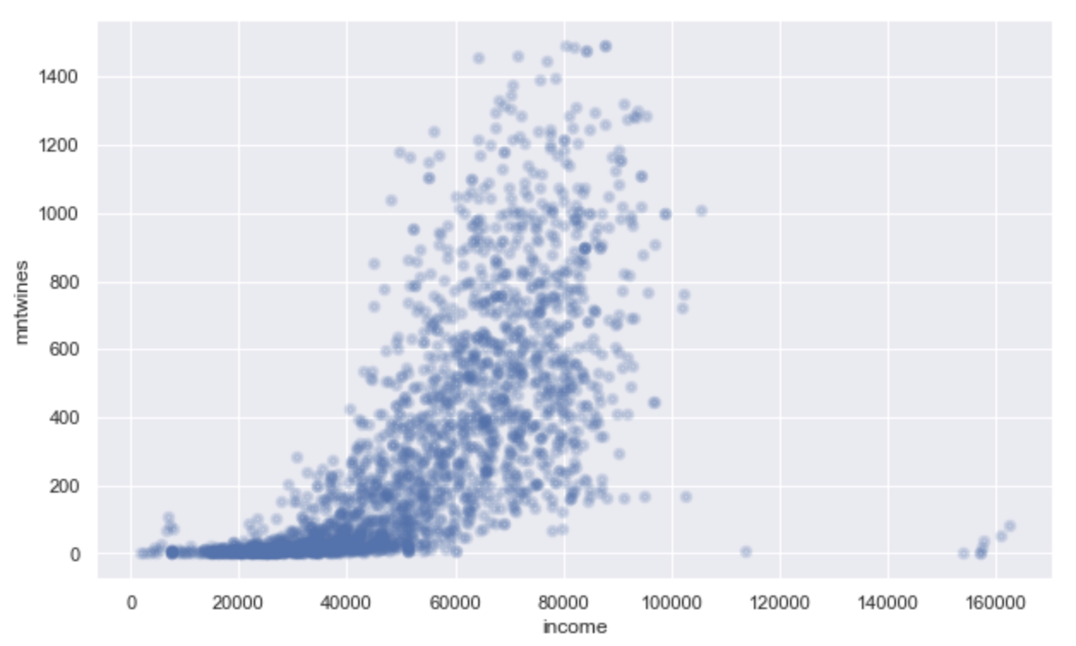

Insights: demographic
Customers with higher income are more likely to spend more on wines

Slide 11
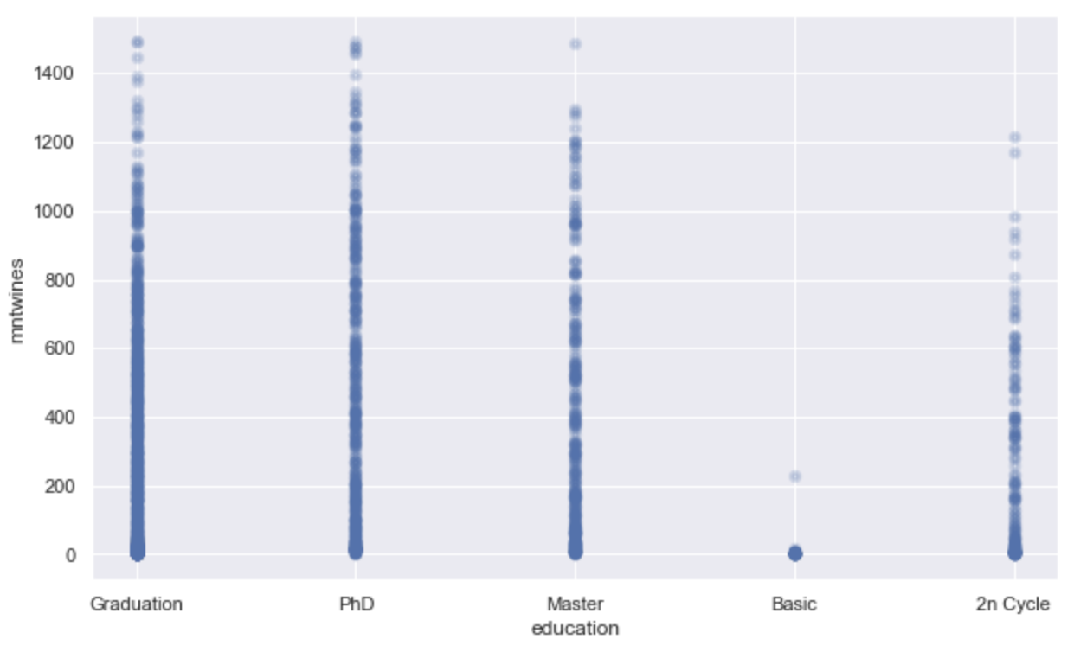

Insights: demographic
Higher educated customers also spending more on wines

Slide 12
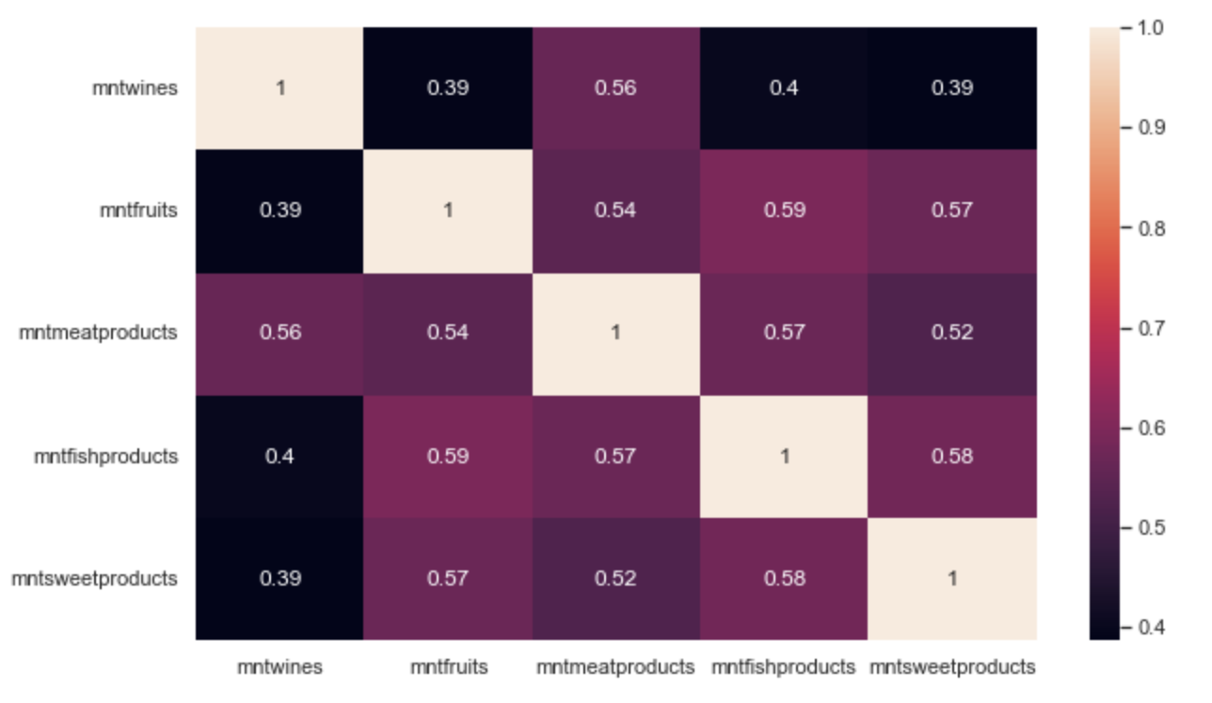
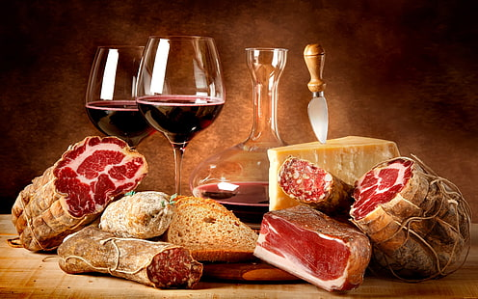
Insights: Product paring
Customers tends to buy wine with meat products

Slide 13
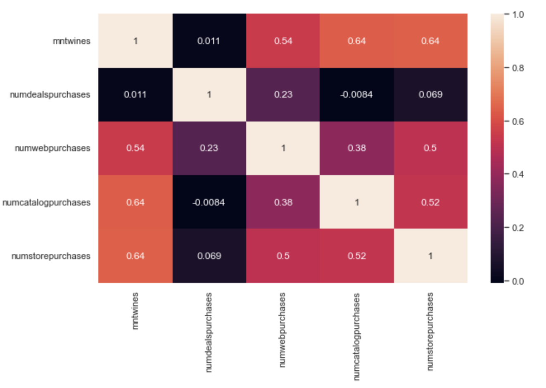

Insights: Purchase channel
Customers are buying wine online almost as much as buying at store

Slide 14
Hypothesis testing
Null Hypothesis: Website visits do not contribute to online wine sales
Alternative Hypothesis: Website visits contribute to online wine sales
Significant p-value: 0.05
Outcome: 0.001 We reject our Null Hypothesis
Conclusion: Website visits contribute to online wine sales

Slide 15
Summary & What’s next?
Online shop has a positive impact on the amount customers spend on wines
Higher educated group of customer are happy to spend more on wines
Next step
Developing a model to identify what type of marketing campaign create the most impact to the conversion rate of the sale of wines

Slide 16

Question ?

